Slide 1
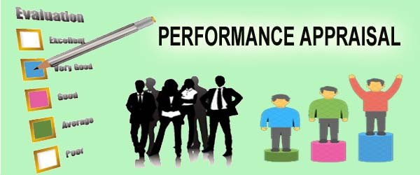
Unit 4
Performance Appraisal

Slide 2
Performance and Effectiveness
Generally Performance Appraisal is the process of evaluation and judgment of employee by employer.
According to Fletcher and Perry (2001, pp. 127) ‘’ Performance appraisal is the term applied to a variety of processes that generally involve the assessment and development of an individual and their performance at work, both in term of their existing effectiveness and their potential for advancement’’.

Slide 3
“Performance Appraisal is the systematic description of job-relevant strengths and weakness of an individual or group” Waney F. Cascio
“Performance Appraisal is a process that involves determining and communicating to an employee how s/he is performing the job and ideally, involves establishing a plan of improvement.”
Bayers & Rue

Slide 4
Why appraise performance?
Appraisals play an integral role in the employer’s performance management process.
Appraisals help in planning for correcting deficiencies and reinforce things done correctly.
Appraisals, in identifying employee strengths and weaknesses, are useful for career planning
Appraisals affect the employer’s salary raise decisions.

Slide 5
Performance Appraisal – The Typical Process
Establish Performance Standards
Communicate Performance Standards
Measure Actual Performance
Compare Actual Performance with Standard
Discuss Appraisal with the Appraisee
Positive Reinforcement and Corrective Measures

Slide 6
Steps Involved in Process of Performance Appraisal
1. Establish Performance Standards:
The appraisal process begins with the establishment of per­formance standards. The managers must determine what outputs, accomplishments and skills will be evaluated. These standards should have evolved out of job analysis and job descriptions.
These performance standards should also be clear and objective to be understood and measured. Standards should not be expressed in an articulated or vague manner such as “a good job” or “a full day’s work” as these vague phrases tells nothing.

Slide 7
2. Communicate Performance Expectations to Employees:
Once the performance standards are established, this need to be communicated to the respective employees so that they come to know what is expected of them. Past experience indicates that not communicating standards to the employ­ees compounds the appraisal problem.
Here, it must be noted that mere transference of information (relating to performance standards, for example) from the manager to the employees is not communi­cation It becomes communication only when the transference of information has taken place and has been received and understood by the employees’.
The feedback from the employees on the standards communicated to them must be obtained. If required, the standards may be modified or revised in the light of feedback obtained from the employees. It is important to note that communica­tion is a two-way street.

Slide 8
3. Measure Actual Performance:
This is the third step involved in the appraisal process. In this stage, the actual performance of the employee is measured on the basis of information available from various sources such as personal observation, statistical reports, oral reports, and written reports.

Slide 9
4. Compare Actual Performance with Standards:
In this stage, the actual performance is compared with the predetermined standards. Such a comparison may reveal the deviation between standard performance and actual performance and will enable the evaluator to proceed to the fifth step in the process, i.e., the discussion of the appraisal with the concerned employees.

Slide 10
5. Discuss the Appraisal with the Employee:
The fifth step in the appraisal process is to communi­cate to and discuss with the employees the results of the appraisal. This is, in fact, one of the most challenging tasks the manager’s face to present an accurate appraisal to the employees and then make them accept the appraisal in a constructive manner.
A discussion on appraisal enables employees to know their strengths and weaknesses. This has, in turn, impact on their future performance. Yes, the impact may be positive or negative depending upon how the appraisal is presented and discussed with the employees.

Slide 11
6. Initiate Corrective Action:
The final step in the appraisal process is the initiation of corrective action when it is necessary. The areas needing improvement are identified and then, the measures to correct or improve the performance are identified and initiated.
The corrective action can be of two types. One is immediate and deals predominantly with symptoms. This action is often called as “putting out fires.” The other is basic and delves into causes of deviations and seeks to adjust the difference permanently.
This type of action involves time to analyze deviations. Hence, managers often opt for the immediate action, or say, “put out fires”. Training, coaching, counseling, etc. is the common examples of corrective actions that managers initiate to improve the employee performance.

Slide 12
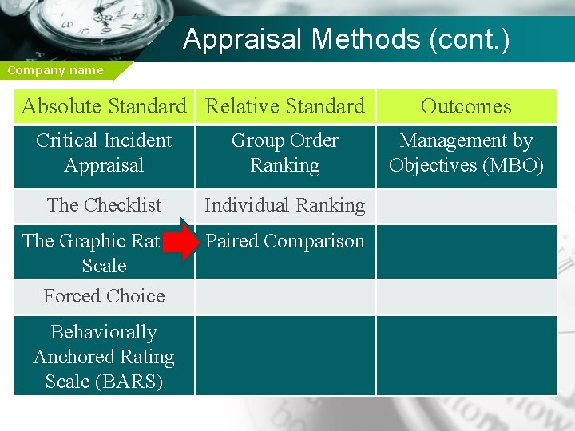
Performance evaluation methods or appraisal methods
Absolute standards: means that subjects are not compared with any other person .

Slide 13
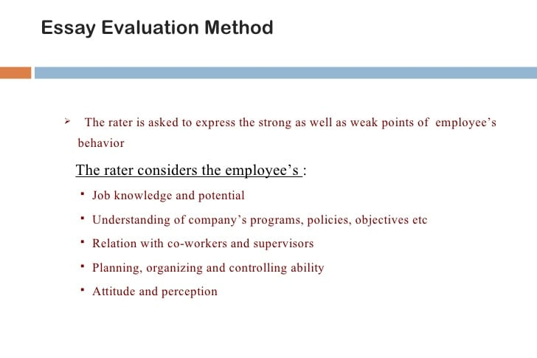
a.

Slide 14
b) Critical incident appraisal
It focuses the ratter's attention on those critical or key behaviours that make the difference between doing a job effectively and doing it ineffectively.
This methods say that an employee is aggressive or imaginative or relaxed but that does not tell us anything about how well the job is being done.
The strength of this method is that it looks at behaviour's.

Slide 15
Its drawbacks are
Appraisers are required to regularly write these incidents down, but doing this on a daily or even weekly basis for all of their subordinates is time consuming and burdensome for managers
Critical incidents suffer from the same comparison problem found in essays; mainly, they do not lend themselves to quantification. Therefore the comparison and ranking of subordinates is difficult.

Slide 16
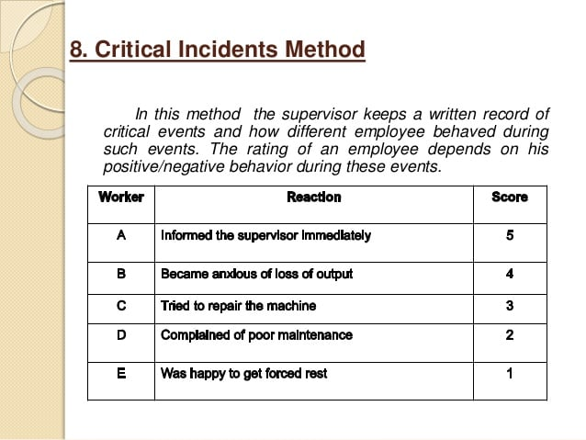

Slide 17
c) Checklist
In the checklist the evaluator uses a list of behavioural descriptions and checks off those behaviours that apply to the employee.
Here the rater only does the reporting or checking and HR department does the actual evaluation.
Advantages – economy, limited training required, standardization.
Disadvantages – Raters biases, use of improper weighs (analyse) by HR, does not allow rater to give relative ratings

Slide 18
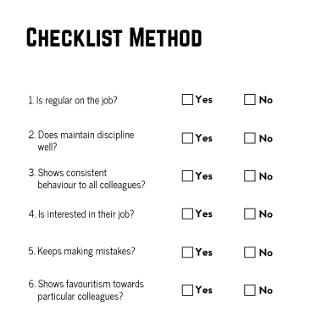

Slide 19
d) GRAPHIC RATING SCALE
A performance appraisal that rates the degree to which the employee has achieved various characteristics.
The rater is provided with a printed form for each employee to be rated, containing a number of characteristics to be rated.
The graphic rating scale is the most common type of
appraisal used.
Various characteristics such as job knowledge, cooperation, loyalty, honesty, punctuality are rated by the degree of achievement.
The rate usually receives a score of 1 to 5, with 5
representing excellent performance.

Slide 20
Carefully constructed graphic rating scales have a number of advantages:
1. Standardization of content permitting comparison of employees. 2. Ease (facility) of development use and relatively low development and usage cost. 3. Reasonably high rater and ratee acceptance.
A disadvantage of such rating scales is that they are susceptible (capable of) to rating errors which result in inaccurate appraisals.

Slide 21
e) Forced Choice Method:
The series of statements arranged in the blocks of two or more are given and the rater indicates which statement is true or false.
The rater is forced to make a choice. HR department does actual assessment.
The list of choices for each question will contain negative or positive traits or behaviours.
Thus, sometimes supervisors must select among positive traits or behaviours and sometimes supervisors will have to select from negative traits or behaviours.

Slide 22
Since these choices are either negative or positive, the supervisor does not know which answer is the best answer.
Example 1
1. He is hard working.
2. He gives clear instructions to his subordinates.
(make a choice)
Example 2
1. He cannot be depended upon for good working.
2. He shows favouritism towards some employees.
Advantages – Absence of personal biases because of forced choice.
Disadvantages – Statements may be wrongly framed.

Slide 23
f) Behaviourally Anchored (attached) Rating Scales (BARS)
Behaviourally Anchored Rating Scales (BARS) are designed to bring the benefits of both qualitative and quantitative data to the employee appraisal process.
BARS compare an individual’s performance against specific examples of behaviour that are anchored to numerical ratings.
For example, a level four rating for a nurse may require them to show sympathy to patients while a level six rating may require them to show higher levels of empathy and ensure this comes across in all dealings with the patient.
(Empathy = the power of understanding and imaginatively entering into another person's feelings.)

Slide 24
The behavioural examples used as anchor points are often collected using Critical Incident Techniques (CIT), which are procedures used for documenting human behaviour that have significance in a particular area.
The BARS approach offers several key advantages:
It’s behaviourally based. The BARS system is totally focused on employee performance. Ideally, it removes all uncertainty regarding the meaning of each numerical rating.
It’s easy to use. The clear behavioural indicators make the process easier for the manager to carry out and the employee to accept.
It’s equitable. With its heavy emphasis on behaviour, the evaluation process comes across as fair.

Slide 25
It’s fully individualized. From the standpoint of consistency within a company, BARS is designed and applied individually and uniquely for every position.
It’s action-oriented. With an understanding of the specific performance expectations and standards of excellence, employees can much more easily take steps to improve their performance, and they’re more likely to do so as a result.
Here are some of the drawbacks to the BARS approach:
The process of creating and implementing BARS is time-consuming, difficult and expensive. Each BARS form must be created from scratch for every position in the company.

Slide 26
Sometimes the listed behaviours still don’t include certain actions required of the employee, so managers can have difficulty as signing a rating.
It’s high maintenance. Jobs change over time, which means that BARS requires a high degree of monitoring and maintenance.
It’s demanding of managers. In order to successfully conduct BARS evaluations, managers need detailed information regarding the actions of their employees. Gathering such data can be quite time-consuming, and many managers end up letting this slide.

Slide 27
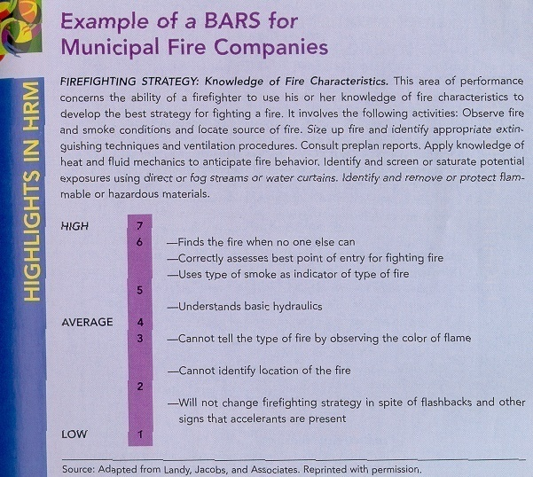

Slide 28
B. Relative standards (Comparative methods)
In this method we can compare two or more employee’s performance
‘A’ have better performance than ‘B’ and ‘AB’ have better performance than ‘C’
Methods
Individual ranking
List out the employee in an order from highest to lowest

Slide 29
2. Paired Comparison
This method is organized way of obtaining a rank-order listing of employees.
It requires the comparison of each employee with every other employee one at a time.
If there are N employee to be rated, then N(N-1)/2 separate comparisons must be made.
level of education
As compared to | Rabin | Prabin | Sima | Dina
Rabin | *
Prabin |  | *
Sima |  |  | *
Dina |  |  |  | *

Slide 30
3. Group order ranking
This method has been designed to prevent supervisors form clustering their employees at the high end of the scale.
For example: Top five, top ten, twenty and so on
Comprehensive methods
Appraisal by result and MBO
360 (degree) appraisal

Slide 31
Comprehensive methods
Appraisal by result and MBO
360 (degree) appraisal
Appraisal by result and MBO
Management by objective has been described as a philosophy of management which seeks to minimize external controls and maximize internal motivation through joint goal setting between the manager and the subordinate and increasing the subordinate’s own control of his work.
It is a process whereby the superior and subordinates of an organization jointly identify its common goals, define each individual’s major areas of responsibility in terms of results expected of him and use these measures as guides of operating the unit and assessing the contributions of each of its members.

Slide 32
The MBO process consists of four steps
Joint goal setting : manager and subordinate formulate the goal after discussion.
Action planning : realistic action plans (day to day plan) are developed to attain the goal already established.
Self-control: it is the systematic monitoring and measuring of his/her performance by the individual.
Periodic progress reviews.
If goal is not reached, then he/she have to identify where he need further development in performing his functions more effectively

Slide 33
2. 360 degree appraisal
This process involves collecting perception about a person’s behaviour, and the report about that behaviour’s impact on the boss or bosses, other direct report form colleagues, fellow members of project teams, internal and external customers, suppliers and customers.
The purpose of feedback is to assist each worker to understand his own strengths and weaknesses and offer insights into aspects of his work, which need professional help to develop.

Slide 34
Features of 360° Degree Appraisal
A well-managed 360-degree processes have the following positive features
• Improved feedback from peers, reporting staff. co-workers, and supervisors
• Team development helps team members to learn to work more effectively together.
Career and personal development of employees is made more feasible, because multi rater feedback can provide excellent information about individuals. They help to disclose what they need to do to enhance their career.
Discrimination risk is reduced because judgment errors of supervisors are reduced, because feedback comes from various sources..
Improved customer services result from the fact that internal and external customers directly involved in the process. So, each employee receives the feedback that is needed.
Training needs assessment is made easier because, multi-rater feedback provides comprehensive information about training needs.

Slide 35
Factors affecting performance appraisal (factors that can distort appraisal)
Interpersonal relations (bias):-
how a supervisor feels about each of the individuals’ working for him has a tremendous effect upon his ratings of their performance.
This is especially found in those situations where objective measures of performance are either not available or difficult to develop.
Miscellaneous biases:
biases against employees on ground of sex, race, religion, position is also a common error in rating. Besides these, there may be opportunity bias and group characteristic bias.

Slide 36
Leniency error:
Some supervisors tend to rate all their subordinates consistently low or high. These are referred to as strictness and leniency errors.
The strict rater gives ratings lower than the subordinate deserves. This strictness error penalizes superior subordinates.
The lenient rater tends to giver higher ratings than the subordinate deserves.
Strictness-leniency bias presents less of a problem when absolute standards and results-oriented approaches to performance appraisal are used.

Slide 37
Central Tendency:
Some raters are reluctant to rate subordinates as very high or very low. They dislike being too strict with anyone by giving them an extremely low rating, and they may believe that no one ever deserves to get the highest possible rating.
The result of this type of attitude is that everyone is rated around average.

Slide 39
Halo Effect
It is the phenomenon whereby we assume that people are good at doing A they will be good at doing B, C and D (or the reverse—because they are bad at doing A they will be bad at doing B, C and D).
For example, the supervisor likes Tom because he is so cooperative. The halo effect leads Tom’s supervisor to automatically rate him high on all appraisal dimensions, including leadership, management, personnel administration, administrative teaming, and even budgeting.

Slide 40
Recency of Events:
Ideally, performance appraisals should be based on data collected about a subordinate’s performance over an entire evaluation period (usually six months to a year).
However, as is often the case, the supervisor is likely to consider recent performance more strongly than performance behaviors that occurred earlier. This is called the recency of events error.

Slide 41
Inappropriate Substitutes for performance
The appraisal is frequently made by using substitutes for performance, such as criteria that closely approximate performance and act in its place. Many of these substitutes are well chosen and give a good approximation of actual performance.
However, the substitutes chosen are not always appropriate. Organizations use criteria such as enthusiasm, conscientiousness and a positive attitude as substitutes for performance.
In some jobs one or more of the criteria listed above are part of performance. Enthusiasm does enhance the effectiveness of a teacher. But enthusiasm may not be relevant to effective performance for many accountants or watch repairers. So what may be an appropriate substitute for performance in one job may be totally inappropriate in another.

Slide 42
Low appraiser motivation
Unclear standards

Slide 43
Benefits of performance appraisal
It encourages employees to perform better in the future
It presents an opportunity for employees to leverage positive performance for an increase in salary or promotion
During the appraisal, employees can discuss strengths and weaknesses with a supervisor, in effect, allowing employees to discuss personal concerns
It provides communication between a supervisor and employee on a regular basis to discuss job duties and issues with work performance

Slide 44
It allows employees to identify what skills may be lacking and need to be acquired or improved upon. There are instances when education provided by the company is a necessity to advance success overall
It holds employees accountable for their job performance, and since the employee knows that an appraisal is coming, the employee has the opportunity to prepare in advance
It provides the opportunity for managers to explain organizational goals and the ways in which employees can participate in the achievement of those goals

Slide 45
Improving employee performance
“give your people, encouragement”
Make the job important in the eyes of the employee.
Select a person who has the potential to perform the job.
Clarify what’s expected of the employee in the job.
Train the employee in the necessary knowledge, skills, and attitudes.
Evaluate performance, and communicate results and expectations to the employee.
Help him improve performance.
Build and maintain relationship with the employee.
Reward for performance.

Slide 46
Evaluation Interviews (Appraisal Interviews)
A good evaluation interview contains following tasks and procedures:
Preparing for the performance evaluation interview
Familiarizing job description
Publish the interview schedule in advance
Be prepared for discussion
Conducting the performance appraisal interview
Opening the interview
Discussing performance
Closing the interview
Review of expectations

Slide 47
1. Preparing for the performance evaluation interview
Proper plan is important to conduct effective performance appraisal interviews. Because it enables both a supervisor and an employee to realistically assess performance.
Familiarizing job description:
What job need to be performed by employee?
What are the organizational goals and policies?
Supervisor need to know the organizational policies and procedures, related to employee performance and work conditions.

Slide 48
Publish the interview schedule in advance
Schedule a performance review at least a week in advance.
Plan for 30-45 minutes in a private setting is free from interruptions.
Both the supervisor and the employee should have a copy of the performance appraisal from and each should, prior to the interview, review the job responsibilities and assess performance levels.
So, both the supervisor and employee should enter the interview as active participants in the PA process.

Slide 49
Be prepared for discussion:
Major responsibilities that the employee is performing successfully
Areas for improvement,
Recommendation for future goals and
And other concerns.

Slide 50
2. Conducting the performance Appraisal interview
Measure actual results against expected results, and plan for the future.
Opening the interview
Set a tone for the interview that exhibits openness and support.
Review the purpose of the meeting: clarity any questions that employee has and repeat that the interview serves to promote employee development.
Regard the employee as an individual. Special concerns should be given to the employee’s communication style.

Slide 51
b. Discussing performance
Be prepared: make ready relevant document to support your view.
The employee should present his or her self-assessment first: show what yours’ strengths are and what assistance do you need.
The supervisor should present his or her assessment of the employee’s performance after hearing the employee’s assessment: list out the agreed and disagreed area and other important topic.
Communication should be two-way

Slide 52
Listen first, provide time to explain and ask open-ended question.
Try to find out the solution of each problem
Setting training and development goals. It could be
Short term training
Going University
Accepting higher responsibility
Moving to next department etc

Slide 53
c. Closing the Interview
Summarize what has been discussed and agreed upon, making sure of consensus on all important points. Do this positively and enthusiastically.
Give the employee an invitation to react, question and share additional ideas and suggestions.
Set a date for the next performance review session.
Thanks each other
Complete and disseminate the appraisal form

Slide 54
3. Review of Expectations
Counseling Employee with Problems
It is the process directed towards helping supervisors and staff members to overcome work related shortcoming, strengthen performance and maintain a successful employment relationship.
HR staff must be available to line managers and employees for assistance and support with performance improvement counseling and discipline process.
Disciplinary actions is the last options of PA.

Slide 55
Performance Appraisal Practices in Nepalese Organization
Features of PA in Nepal
Unclear standard
Low priority in practices
Formal vs. informal: formal in large organization and informal in small and private organization
Purpose of appraisal: employee development, wages and salary, guide to job changes are rarely used it used only for promotion purpose
The issue of fairness and transparency
Organization wise different

Slide 56
PA practices in different sectors/organization
Government office
Appraisal is done once a year.
40 marks is allocated for PE purpose
Immediate supervisor 25
Reviewer 10
Review committee 5
Affecting factors
Political affiliation
Nepotism/favoritism
Loving and hating
Public enterprise
Followed general principles of Govt. office
Twice in a year
Appraisal process
Supervisor
Reviewer
Division chief/ Chief executive
Affecting factors also seen in public enterprise

